Slide 1
Mobile app for sharing or pooling of agricultural produce to market.

Slide 2
Introduction
Sharing and pooling of produce to market through an app is a platform that consists of two interfaces.
One is for the user(Farmer) and the other is for the driver.
It basically reduces the cost of transportation by combining many requests together if required.

Slide 3
Motivation
A farmer need to transport produce to market during harvest time, which is a very common requirement.
The aim is to provide a bridge for communication between a user and driver.
The main motive is to reduce the cost of transportation by pooling multiple users together.

Slide 4
Software Requirements :
JAVA SDK.
Android studio IDE (with SDK bundle).
Hardware Requirements :
Processors: Intel Atom® processor or Intel® Core™ i3 processor.
Input device (mouse / track pad) to select options.
32 – 64 bit processor.
Sufficient RAM to run the program.

Slide 5
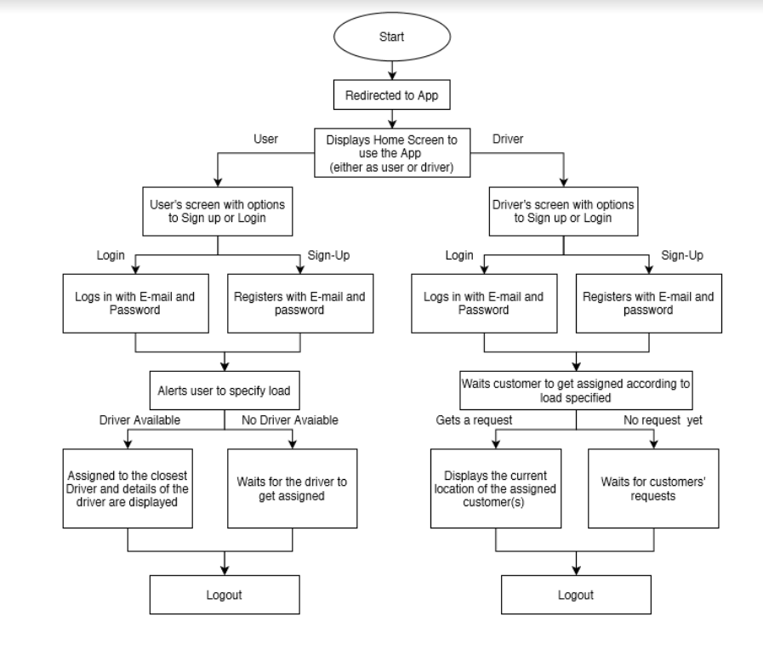
Architecture

Slide 6
Implementation

Slide 7
Driver’s Interface
Driver's interface consists of a login created for him, which has all the details about the driver including his vehicle's number, overall rating etc. which is visible to the user who booked that vehicle.
It also has a section that consists of all the requests placed by multiple users, from which he can accept a request and obtain the location details of the farmer.

Slide 8
User’s (Farmer’s) Interface
It is the main body of the app where users can book a vehicle for transportation of produce.
Based on the number of requests placed and their load capacity, assignment of drivers would be done thus reducing wastage of transportation expense.

Slide 9
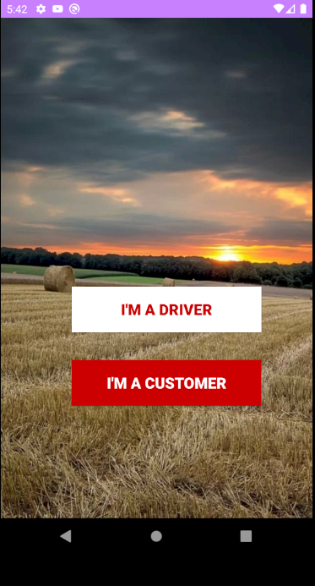
Home Screen
This screen will have two buttons i.e. I’M A DRIVER and I’M A CUSTOMER .
Users will be directed to their respective logins based on the option they have chosen.

Slide 10
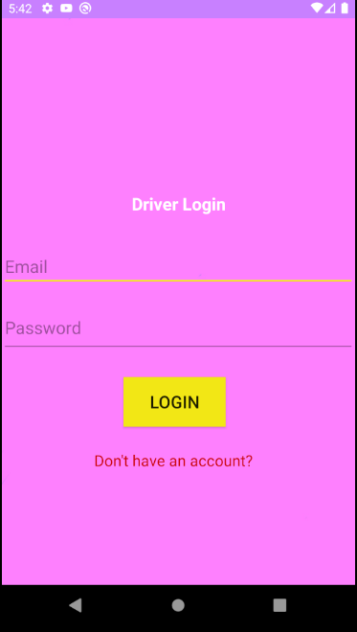
Driver’s Login Screen
This is the login portal of driver.
They can login directly if they've initially created an account or they can create one by clicking on the option(Don't have an account?)

Slide 11
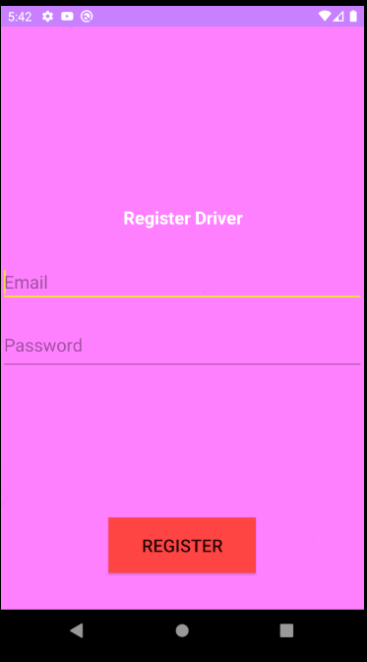
Driver’s Registration Screen
A driver can create an account here in this page.
After successful registration the driver can login thereafter.

Slide 12
The same screens appear for user as well

Slide 13
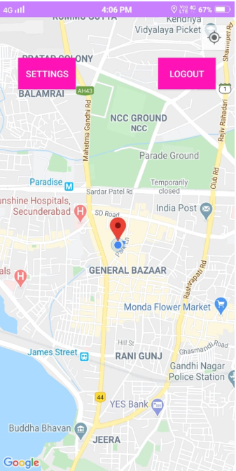
Driver’s Portal Screen
This is the screen to which the driver will be redirected to after the successful login.
The driver will be able to see his live location on the Google map.

Slide 14
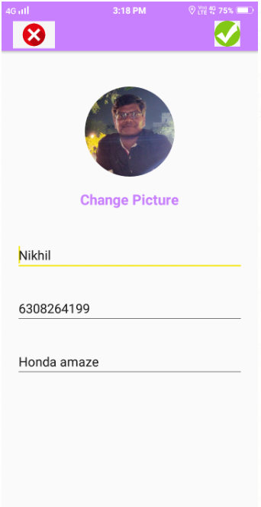
Driver’s Settings Screen
This is the settings page of a driver.
Here the driver can give his details, upload his image and can even change them whenever required.

Slide 15
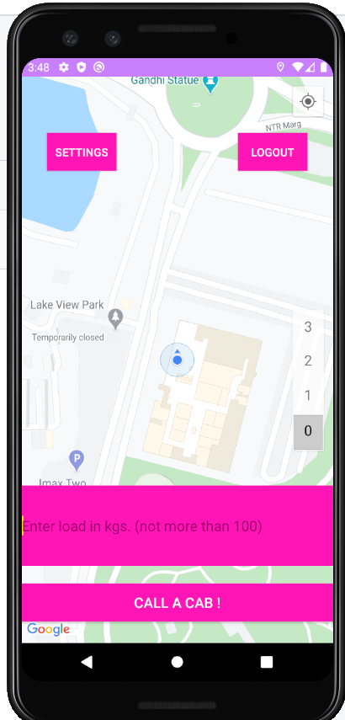
User’s Portal Screen
This is the screen user will be redirected after successful login.
Live location of that specific customer will be tracked on the Google map.
Here, the customer can update his details or he can call a cab.

Slide 16
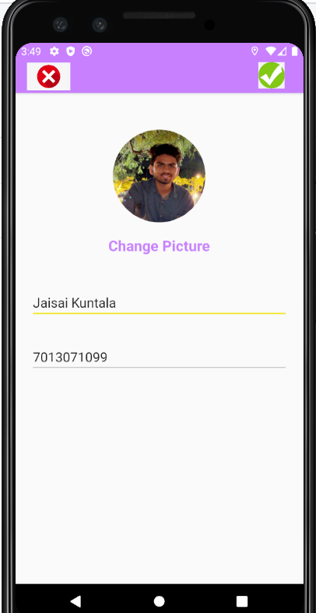
User’s Settings Screen
This is the settings page of a driver.
Here the driver can give his details, upload his image and can even change them whenever required.

Slide 17
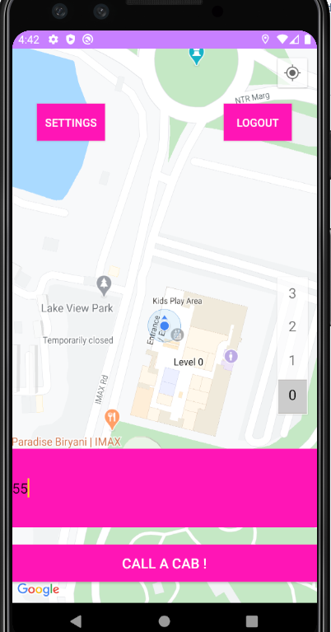
Calling a Cab!!
Now, this customer has entered the load of 55 kilograms.

Slide 18
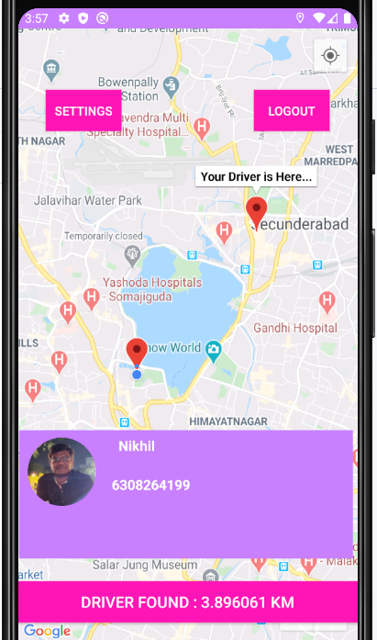
User portal after assigned with driver
After the successful assignment of a driver, the customer can see the driver's location along with the distance.
Here the closest driver with the remaining load capacity greater than or equal to the entered load (here 55 kilograms) will be assigned to this customer.

Slide 19
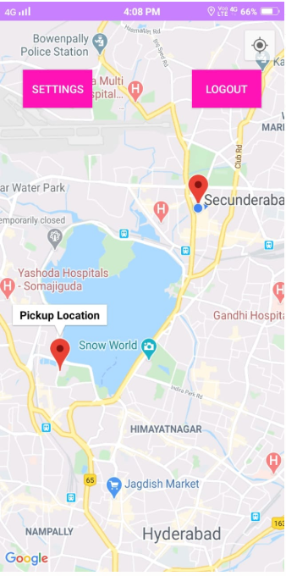
Driver’s Screen after customer assigned
This is the screenshot of the driver's map where he can see the pickup location of the assigned customer.

Slide 20
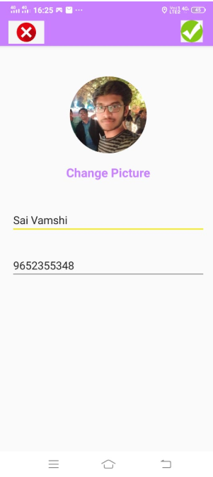
Screen of New Customer
This is the settings page of a user.
Here the user can give his details, upload his image and can even change them whenever required.

Slide 21
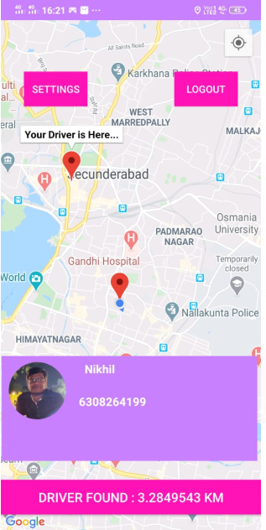
Screen of the New Customer
The new customer has entered a load of 30 kilograms.
He will now be assigned to the same driver as he is the nearest driver having a remaining load capacity of 45 kilograms
He will also be able to see how far the driver along with the live location.

Slide 22
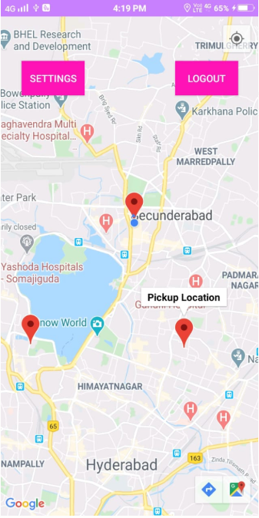
Screen of the common driver
Finally, the driver will be able to see two markers on his map, because two different farmers have been pooled to reach the market.
Therefore, the transport expenses will be shared among both the farmers and hence the cost is reduced.

Slide 23
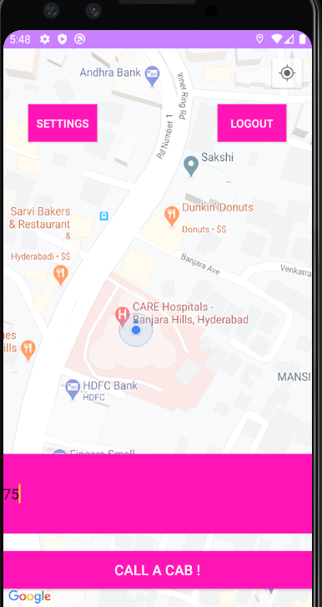
Screen of new user who has requested a driver with excess load capacity
Now, there is only one driver and his load capacity is 15 kilograms.
Another customer calls a cab requesting to transport a load of 75 kilograms which is not possible because there is only one driver with less capacity.

Slide 24
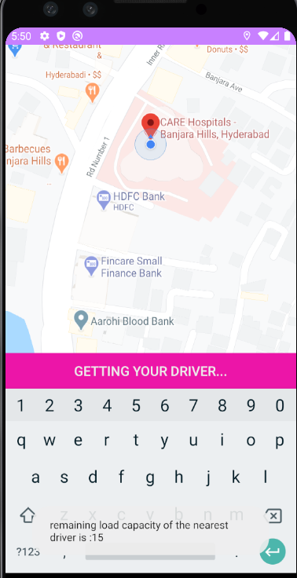
Pop-Up message displayed
So, the customer will see a pop-up saying, "remaining load capacity of the nearest driver is only:15”.
Now it continues to search for the next nearest driver with the required capacity.

Slide 25
Advantages :
Good user interface which is highly intuitive and easy to understand.
The cost of transport is drastically reduced by using this app as multiple rides are clubbed together based on the location proximity of the farmers.

Slide 26
Drawbacks :
Internet connection is mandatory.
Farmers who don’t understand English, might find it little difficult to use the app.
We’ve used Android API 24, which runs on almost 70% of the devices only.

Slide 27
Conclusion and Future Scope
The application can be extended by allowing pooling of rides based on volume or type of the crop rather than weight.
This makes users to get assigned with a driver in accordance to their particular requirement.
Further cancellation of rides can also be added.
Route maps can be shown, displaying the estimated time of approach as well.
Online payment service can be implemented for the collection of ride fares.

Slide 28
THANK YOU !!!

